Slide 1
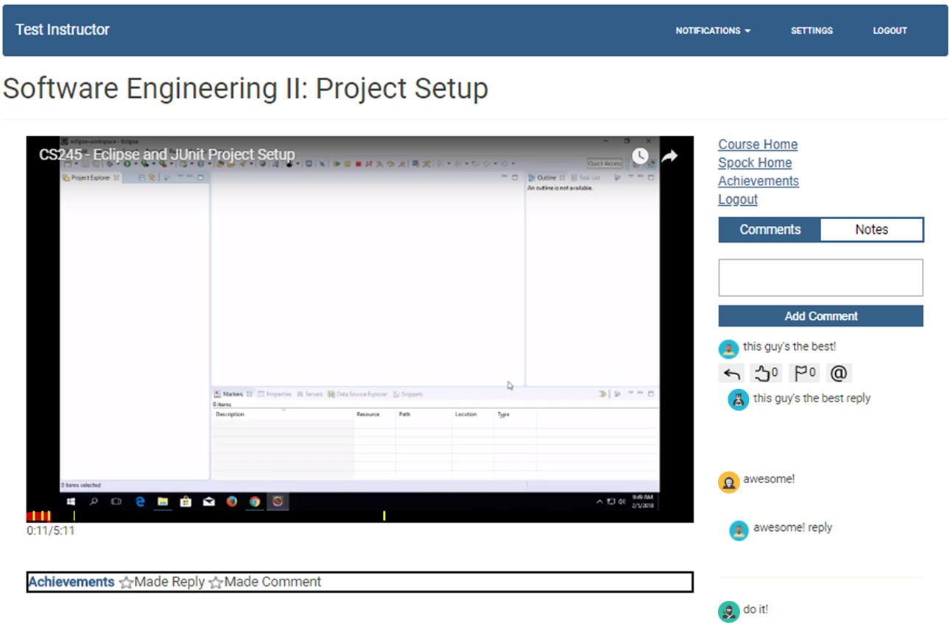
SPOCK
Small Private Online Course Keeper
Thomas Schuler (schulets@uwec.edu) | Ryan Hardt (hardtr@uwec.edu)
Computer Science Department
Features
Fine-grained lecture comments
Gamification achievements to encourage participation and early completion
Anonymous comments
Fine-grained, private lecture notes
MOOCs (Massive Open Online Courses) are designed to serve large groups of students, but SPOCs (Small Private Online Courses) are intended for smaller class sizes. As a result, SPOCs are better suited for user interaction in the form of comments associated with fine-grained lecture content.
Achievements
Commenting
Replying
Providing comment feedback (Helpful/Flag)
Receiving “Helpful” feedback
Finishing a lecture “early”
Finishing a lecture
Receiving “x” instances of these achievements
What’s Next?
Fix bugs
Alpha and beta testing
Empirical evaluation to answer the following research questions:
Does gamification increase the amount of student interaction in an online lecture tool?
Does an anonymous comment system increase participation in an online lecture tool?
Do students prefer the gamification-based interaction system?
This part confuses me!
It helped me to google it
Anyone else just love Eclipse?
It’s a super helpful IDE!
Remember to pause the video and practice these steps!
Comments
Commenters are identified to other students using a random icon assigned to each commenter for a given lecture
Replies appear below the initial comment in the scrollable comments section
Comment presence is identified in the timeline at the timestamp with which they are associated
Comments and replies appear in the comments section at their associated time and disappear after a pre-determined amount of time has passed
Commenters and repliers can be notified via email when replies are added
Students value interaction with other students in SPOCs. Systems that provide a means for interaction suffer from a seeding issue where early lecture viewers lack interaction with others. SPOCK’s gamification system aims to address this.
Printed by Learning and Technology Services

