Slide 1
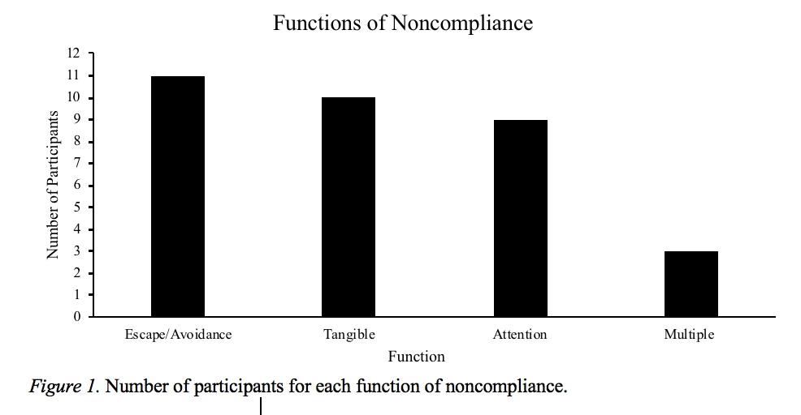
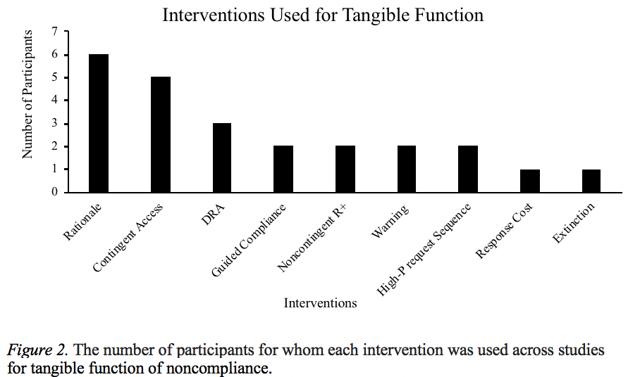
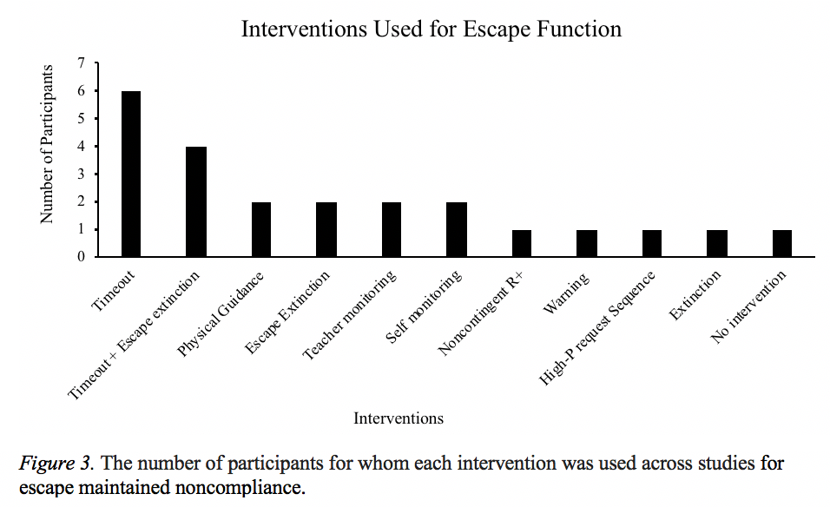
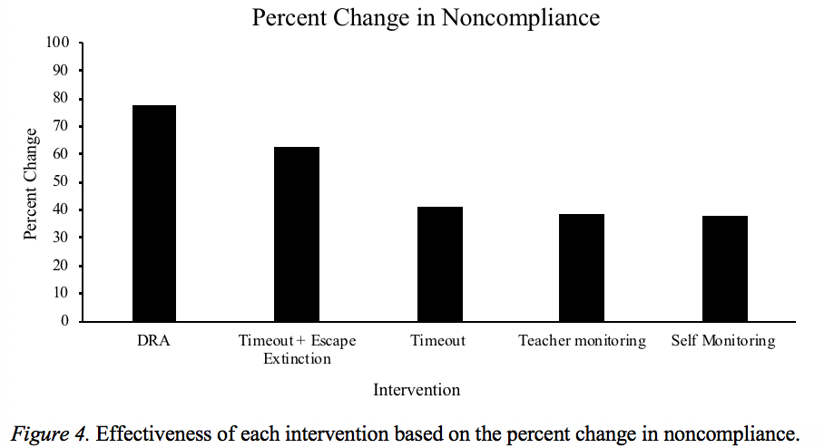
A Review of the Literature Pertaining to Noncompliance
Hannah Marose, Robyn Gehri and Kevin Klatt, Ph.D. | Psychology
ABSTRACT
RESULTS
METHODS
A lot of research exists to address noncompliance for children and adults. Several reviews of the literature pertaining to noncompliance exist; however, none of the reviews have investigated the functions of noncompliance nor the effectiveness of the function-based interventions. Therefore, the purpose of the current literature review was to examine the functions of noncompliance and analyze which function-based interventions were the most effective. Past studies which conducted a functional analysis or functional assessment on compliance or noncompliance were collected and organized. Results of this review suggest that the functions of noncompliance include attention, escape, access to tangibles, or combinations of the three. The percentage of effectiveness was calculated for each function-based intervention. The results of the review along with recommendations for future research are discussed.
LITERATURE SEARCH
First, the terms compliance, noncompliance, functional analysis, functional assessment and applied behavior analysis were entered individually and in combination into the PsycINFO and EBSCOhost search engines by two independent researchers. This search generated thirty-two studies. Second, the reference section of each identified study was reviewed to find additional studies that did not appear in the initial electronic searches. Nine additional studies were found through this process.
INCLUSION CRITERIA
Studies were included in this review only if they met the following criteria: (a) published in a peer-reviewed journal, (b) utilized a single-subject design, (c) conducted a descriptive assessment or functional analysis, and (d) the dependent variable of the functional analysis or functional assessment was either compliance or noncompliance.
INTRODUCTION
DATA EXTRACTION
Noncompliance, defined as not starting nor completing a given demand within a predetermined amount of time, is one of the most common childhood behavior problems. The prevalence of noncompliance in children and adolescents is estimated to be between 25% and 65% (Kalb & Loeber, 2003).
The term noncompliance is problematic in that it suggests non-behavior. In the absence of compliance; however, the child engages in other behavior. To treat noncompliance, therefore, accurate identification of the variables responsible for not complying to a demand is important.
To determine the function for engaging in behavior other than compliance, a descriptive assessment or functional analysis can be conducted. The purpose of such an assessment or analysis is to identify the reinforcer for noncompliance (engaging in other behavior). Past studies have shown an experimental relationship between noncompliance and negative reinforcement in the form of avoidance from doing the task, and positive reinforcement in the form of access to preferred activities.
When the specific reinforcer for noncompliance is identified, a more effective function-based intervention can be selected. For example, a child engaging in noncompliant behavior to avoid starting a task might benefit from treatment based on reinforcing compliance in small steps and/or using escape extinction by physically guiding the child to complete the task.
Several studies have investigated the function of noncompliance by either conducting a descriptive assessment (hypothesizing based on interview and observation) and an experimental functional analysis. To date, no review has been conducted on these studies. The purpose of this review, therefore, was to investigate studies that have conducted either a descriptive assessment or functional analysis of noncompliant behavior.
Once researchers identified studies for inclusion, they analyzed the studies based on the following variables: (a) the function identified through a descriptive assessment or functional analysis, (b) the identified function(s), (c) what intervention was used, and (d) the effectiveness of the intervention.
To determine the effectiveness of the intervention, only studies that reported mean baseline and treatment data were included. Effectiveness was calculated by subtracting the mean baseline data from the mean treatment data for each treatment. Once this was completed for each participant, the percentage change in compliance for each specific treatment was averaged across all participants. The average percentage change was then used to compare which treatment resulted in the largest increase in compliance.
DISCUSSION
This review conducted an analysis of 11 studies that investigated the function of compliance/noncompliance. The results show the most common function for noncompliance was avoidance from engaging in compliance, followed by continued access to a tangible item (e.g., a toy), attention, and in some cases multiple functions.
A multitude of interventions have been implemented for noncompliance. The interventions vary according to the identified function. When the results from these interventions are collapsed, the most effective intervention was differential reinforcement (DRA).
The data from this review should be interpreted with caution. For example, the studies in this review investigated noncompliance (engaging in behavior other than compliance). The functions for these other behaviors; however, would not necessarily function as a reinforcer for compliance. That is, a child who does not engage in compliance in order to obtain a tangible item, such as a toy, would not necessarily comply for the toy. Future research should investigate this relationship.

